Slide 1

E-COMMERCE DATABASE
Group 3: Roopali Kallem (RXK180054)
Nguyen Nguyen (NXN210036)
Nihar Vinnakota (NXV230017)
Haritha Jampani (HXJ220031)

Slide 2

INTRODUCTION
E-commerce databases provide a gateway to unparalleled insights, transforming raw information into strategic advantages.
This aim to support business processes, to maintain data integrity between object: Customer, Order, Product, Payment, Supplier

Slide 3
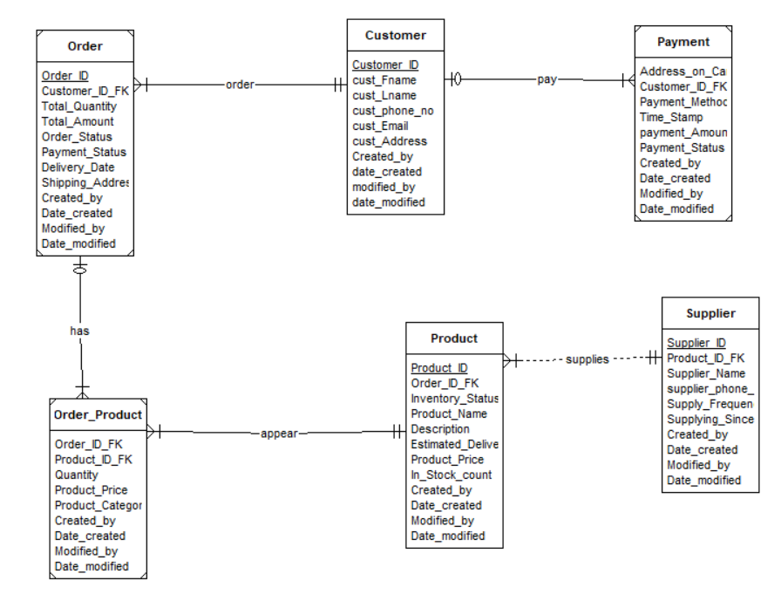
ERD DIAGRAM

Slide 4
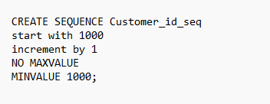
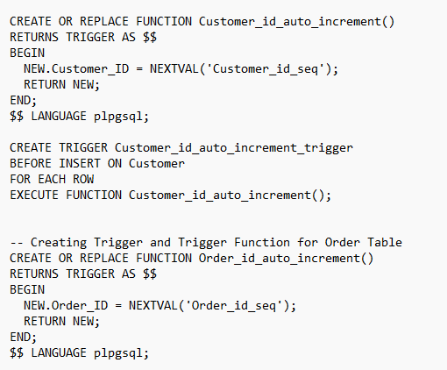
SEQUENCES AND TRIGGERS
SEQUENCES: to generate values starting from 1000 and increasing by 1 each time for Customer_ID field. Sequences created for each table start with 1000, 2000, 3000,4000, 5000
TRIGGERS: to establish an automatic incrementing mechanism for the Customer_ID field. When a new row is inserted into the Customer table, the trigger calls the function, which, in turn, assigns the next sequence value to the Customer_ID field of the newly inserted row.

Slide 5
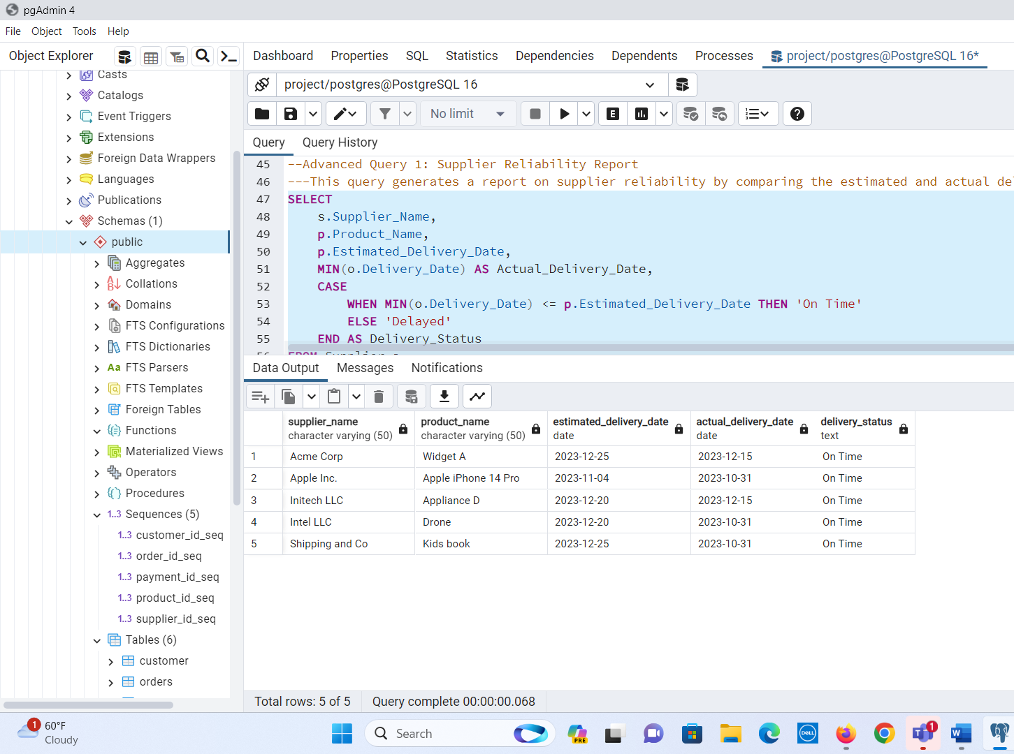
ADVANCES QUERIES and OUTPUTS

Slide 6
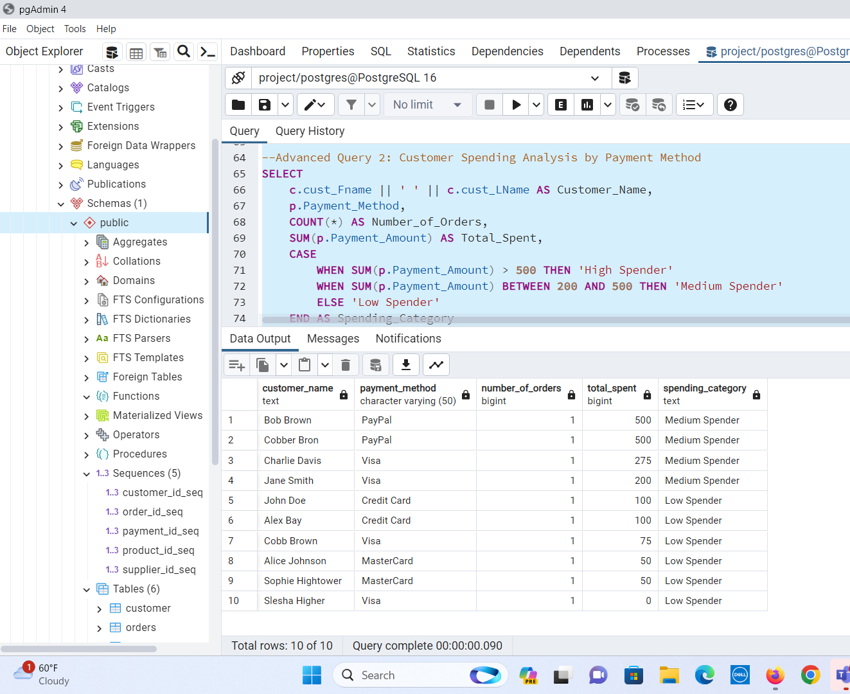
ADVANCES QUERIES and OUTPUTS

Slide 7
CHALLENGES
Challenge about running Trigger to pull data from multi-table
Challenges in meeting group and working together due to difference schedule
Ensuring that we were able to complete the deliverables in a timely manner, in accordance to everyone’s schedule
Figuring out how to create database in PostgreSQL and ensure all our queries ran successfully.

Slide 8
THANK YOU !

